Slide 1

Southeast university
Rich feature hierarchies for accurate object detection and semantic segmentation

Slide 2

00
Abstract
complex ensemble systems
previous
best-performing methods
combine multiple low-level image features with high-level context
propose a simple and scalable detection algorithm
our methods
Improves mean average precision
one can apply high-capacity convolutional neural networks (CNNs) to bottom-up region proposals in order to localize and segment objects
two key insights
when labeled training data is scarce, supervised pre-training for an auxiliary task,
followed by domain-specific fine-tuning, yields a significant performance boost.
Notes:
之前表现最好的方法：1.是一个复杂的系统。2.将多个层级较低的图片特征与层级较高的图片特征相结合
我们的方法：1.提供了一种简单的、刻度量的检测算法
包含两重思考：1.可以将高功率的卷及神经网络应用于region proposal中，以此来局部化分段对象

Slide 3
目录
CONTENT
01 Introduction
04 The ILSVRC2013 detection dataset
02 Object detection with R-CNN
05 Semantic segmentation
03 Visualization, ablation, and modes of error
06 Conclusion

Slide 4
01
Introduction

Slide 5
01
Introduction
Last decade of progress on various visual recognition tasks has been based considerably on the use of SIFT and HOG
blockwise orientation histograms
saw heavy use in the 1990s
fell out of fashion with the rise of support vector machines.
CNN
Was rekindled interest in CNNs by showing substantially higher image classification accuracy
on the ImageNet
vigorously debated during the ILSVRC 2012 workshop
To what extent do the CNN classification results on ImageNet generalize to object detection results on the PASCAL VOC Challenge?

Slide 6
01
Introduction
Answer:
image classification
object detection
First to show that a CNN can lead to dramatically higher object detection performance on PASCAL VOC
localizing objects with a deep network
focused on
two problems
training a high-capacity model with only a small quantity of annotated detection data
“recognition using
regions” paradigm
has been successful for object detection
semantic segmentation
Generates around 2000 category-independent region proposals for the input image
Our method
extracts a fixed-length feature vector from each proposal using a CNN
then classifies each region with category-specific linear SVMs
Notes:
我们把注意力集中到以下两点上：1.使用深度神经网络局部化对象。2.使用一小部分标记过的监测数据进行高功率模型的训练
由于网络架构的特殊性，我们在特征检测中不便于使用滑动窗格，所以我们提出了一种 “识别使用区域”范式，他同时解决了对象检测和语义分段的问题
我们的方法有以三个特性：1.对于每一个输入的图像，我们产生2000个类别独立（类别无关）的region proposal（建议框）
2.对于每个建议域，提取一个定长的特征向量
3.再利用特定类别的线性SVM，将每个建议域进行分类

Slide 7
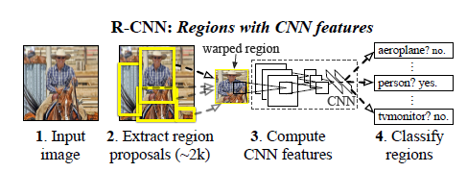
01
Introduction
Step of R-CNN
Generates around 2000 category-independent region proposals for the input image
extracts a fixed-length feature vector from each proposal using a CNN
then classifies each region with category-specific linear SVMs
Notes:
R-CNN特征检测的步骤

Slide 8
01
Introduction
Second challenge faced in detection is that labeled data is scarce and the amount currently available is insufficient for training a large CNN
supervised pre-training on a large auxiliary dataset (ILSVRC）
Solve method
improves mAP performance
by 8 percentage
followed by domain-specific fine-tuning on a small dataset (PASCAL)
The only class-specific computations are a reasonably small matrix-vector product and greedy non-maximum suppression.（ two orders of magnitude lower-dimensional than previously used region features ）
With minor modifications, we also achieve competitive results on the PASCAL VOC segmentation task, with an average segmentation accuracy of 47.9% on the VOC 2011 test set.
Notes:
面临的第二个问题：标记数据稀少，不足以进行较大程度的CNN训练
解决方案：1.在较大的数据集上进行监督式训练；在小样本上进行特定领域的微调
唯一的特定类计算是适度的微小矩阵向量和贪心非极大值抑制

Slide 9
Object detection with R-CNN
02

Slide 10
02
Object detection with R-CNN
Our object detection system consists of three modules.
The first generates category-independent region proposals. These proposals define the set of candidate detections available to our detector.
Three modules
The second module is a large convolutional neural network that extracts a fixed-length feature
vector from each region.
The third module is a set of classs-pecific linear SVMs.
We present our design decisions for each module, describe their test-time usage, detail how their parameters are learned, and show detection results on PASCAL VOC 2010-12 and on ILSVRC2013.
Notes:
对象检测的三个模块

Slide 11
02
Object detection with R-CNN
2.1. Module design
2.1.1 Region proposals.
A variety of recent papers offer methods for generating category-independent region proposals.
objectness
selective search
category-independent object proposals
Examples include:
Constrained parametric min-cuts (CPMC)
multi-scale combinatorial grouping
Ciresan（detect mitotic cells by applying a CNN to regularly-spaced square crops）
Notes:
对象检测的三个模块

Slide 12
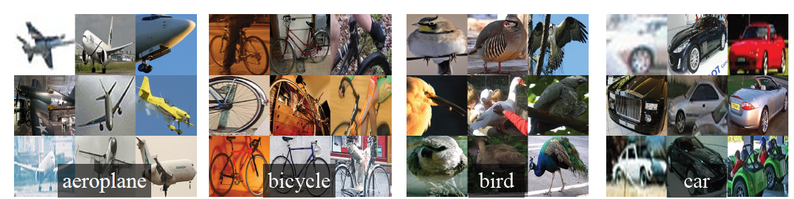
02
Object detection with R-CNN
2.1. Module design
2.1.2 Feature extraction.
We extract a 4096-dimensional feature vector from each region proposal using the Caffe
implementation of the CNN described by Krizhevsky.
Features are computed by forward propagating a mean-subtracted 227*227 RGB image through five convolutional layers and two fully connected layers.
We must first convert the image data in that region into a form that is compatible with the CNN.
Regardless of the size or aspect ratio of the candidate region, we warp all pixels in a tight bounding box
around it to the required size.
Warped training samples
from VOC 2007 train
Notes:
特征检测：从每个建议域中提取了一个4096个维度的特征向量，使用caffe实现卷积神经网络
特征计算：使用前馈传播一个去均值化的227*227的彩色图片，通过5层卷积神经网络和两个全连接层
我们忽略图像本身的宽高比，将所有的像素卷曲到一个围合的区域中来满足输入尺寸

Slide 13
02
Object detection with R-CNN
2.2. Test-time detection
At test time, we run selective search on the test image to extract around 2000 region proposals.
We warp each proposal and forward propagate it through the CNN in order to compute features.
Then, for each class, we score each extracted feature vector using the SVM trained for that class.
Given all scored regions in an image, we apply a greedy non-maximum suppression (for each class independently) that rejects a region if it has an intersection-over union (IoU) overlap with a higher scoring selected region larger than a learned threshold.
Notes:
对于得到的图像中的区域，我们使用贪婪的非极大抑制来抑制含有IoU的区域

Slide 14
02
Object detection with R-CNN
2.2. Test-time detection
Run-time analysis
First, all CNN parameters are shared across all categories.
Two properties make detection efficient
Second, the feature vectors computed by the CNN are low-dimensional when compared to other common approaches, such as spatial pyramids with bag-of-visual-word encodings.
The result of such sharing is that the time spent computing region proposals and features (13s/image on a GPU or 53s/image on a CPU) is amortized over all classes.
The feature matrix is typically 2000*4096 and the SVM weight matrix is 4096*N, where N is the number of classes.
Notes:
1.所有的分类都共享参数
2.与其他常规的方法相比，CNN计算的特征向量维度较低
特征矩阵是2000*4096，SVM权重矩阵是4096*N,N是类的数量

Slide 15
02
Object detection with R-CNN
2.2. Test-time detection
Run-time analysis
This analysis shows that R-CNN can scale to thousands of object classes without resorting to approximate techniques, such as hashing.
This efficiency is not merely the result of using region proposals and shared features.
It is also interesting to contrast R-CNN with the recent work from Dean et al. on scalable detection using DPMs and hashing.
They report a mAP of around 16% on VOC 2007 at a run-time of 5 minutes per image when introducing
10k distractor classes.
With our approach, 10k detectors can run in about a minute on a CPU, and because no approximations are made mAP would remain at 59%.

Slide 16
02
Object detection with R-CNN
2.3. Training
2.3.1 Supervised pre-training
We discriminatively pre-trained the CNN on a large auxiliary dataset (ILSVRC2012 classification)
using image-level annotations only (bounding-box labels are not available for this data).
2.3.2 Domain-specific fine-tuning
To adapt our CNN to the new task (detection) and the new domain (warped proposal windows), we continue stochastic gradient descent (SGD) training of the CNN parameters using only warped region
proposals.
Aside from replacing the CNN’s ImageNet-specific 1000-way classification layer with a randomly initialized
(N + 1)-way classification layer (where N is the number of object classes, plus 1 for background), the CNN
architecture is unchanged.

Slide 17
02
Object detection with R-CNN
2.3. Training
2.3.2 Domain-specific fine-tuning
VOC:N = 20
ILSVRC2013:N = 200
We treat all region proposals with > 0:5 IoU overlap with a ground-truth box as positives for
that box’s class and the rest as negatives.
We start SGD at a learning rate of 0.001 (1/10th of the initial pre-training rate), which allows fine-tuning to make progress while not clobbering the initialization.
In each SGD iteration we uniformly sample 32 positive windows (over all classes) and 96 background windows to construct a mini-batch of size 128.
We bias the sampling towards positive windows because they are extremely rare compared to background.
Notes:
大于0.5的groundtruth重叠部分为positive，剩余为negative
梯度下降时，学习速率为0.001（预训练的1/10），从而在微调时不会打破迭代。
我们对于正样本使样本存在偏差，因为对于背景来说，他们是非常稀有的

Slide 18
02
Object detection with R-CNN
2.3. Training
2.3.3 Object category classifiers.
Consider training a binary classifier to detect cars.
It’s clear that an image region tightly enclosing a car should be a positive example. Similarly, it’s clear that a background region, which has nothing to do with cars, should be a negative example.
We found that selecting this threshold carefully is important.
Positive examples are defined simply to be the ground-truth bounding boxes for each class
Since the training data is too large to fit in memory, we adopt the standard hard negative mining method.
Hard negative mining converges quickly and in practice mAP stops increasing after only a single pass over all images.
Notes:
对象类别分类
图像域所围合的car区域应该是一个积极的例子，而作为与car无关的背景则应该是一个消极的区域
消极样本会进行快速转变

Slide 19
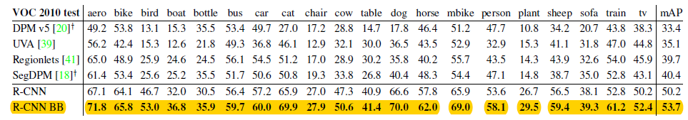
02
Object detection with R-CNN
2.4 Results on PASCAL VOC 201012.
For final results on the VOC 2010-12 datasets, we fine-tuned the CNN on VOC 2012 train and optimized our detection SVMs on VOC 2012 trainval.
Classification is performed with a histogram intersection kernel SVM. Compared to their multi-feature,
non-linear kernel SVM approach, we achieve a large improvement in mAP, from 35.1% to 53.7% mAP, while also being much faster (Section 2.2). Our method achieves similar performance (53.3% mAP) on VOC 2011/12 test

Slide 20
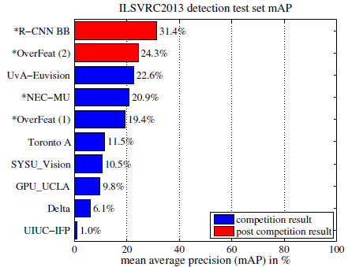
02
Object detection with R-CNN
2.5. Results on ILSVRC2013 detection
We ran R-CNN on the 200-class ILSVRC2013 detection dataset using the same system hyperparameters that we used for PASCAL VOC
We followed the same protocol of submitting test results to the ILSVRC2013 evaluation server only twice, once with and once without bounding-box regression.
Figure 3 compares R-CNN to the entries in the ILSVRC
2013 competition and to the post-competition OverFeat result. R-CNN achieves a mAP of 31.4%, which is significantly ahead of the second-best result of 24.3% from OverFeat.
Notes:
在ILSVRC2013测试集上的正确率。R-CNN的正确率为31.4%，相对于overFeat领先较多

Slide 21
03
Visualization, ablation, and modes of error

Slide 22
03
3. Visualization, ablation, and modes of error
3.1. Visualizing learned features
Oriented edges
First-layer filters can be visualized directly and are easy to understand
Opponent colors
We propose a simple (and complementary) non-parametric method that directly shows what the network learned.
The idea is to single out a particular unit (feature) in the network and use it as if it were an object detector in its own
Right.
That is, we compute the unit’s activations on a large set of held-out region proposals (about 10 million), sort the
proposals from highest to lowest activation, perform non-maximum suppression, and then display the top-scoring regions.
Notes:
我们的可视化学习特征：使用了有向边和对立色彩

Slide 23
03
3. Visualization, ablation, and modes of error
3.1. Visualizing learned features
We visualize units from layer pool5, which is the max-pooled output of the network’s fifth and final convolutional
layer. The pool5 feature map is 6 * 6 * 256 = 9216- dimensional.
Ignoring boundary effects, each pool5 unit has a receptive field of 195*195 pixels in the original 227*227 pixel input. A central pool5 unit has a nearly global view, while one near the edge has a smaller, clipped support
The network appears to learn a representation that combines a small number of class-tuned features together with a distributed representation of shape, texture, color, and material properties
The subsequent fully connected layer fc6 has the ability to model a large set of compositions of these rich features.
Notes:
我们从pool5进行可视化操作，这是网络的第五层，并且也是最终层，pool5的特征图谱是6*6*256
忽略边缘效应，每个pool5的接受域是原接受域227*227中的195*195像素。一个中心的pool5单元近乎拥有全局的视图，而我们可以忽略边缘的细小差异
这个网络可以学习一个将一个分类代表与一小部分微调类的特征相结合的代表

Slide 24
03
3. Visualization, ablation, and modes of error
3.2. Ablation studies
3.2.1 Performance layer-by-layer, without fine-tuning
To understand which layers are critical for detection performance, we analyzed results on the VOC 2007 dataset for each of the CNN’s last three layers.
Layer fc6 is fully connected to pool5. To compute features, it multiplies a 4096*9216 weight matrix by the pool5
feature map (reshaped as a 9216-dimensional vector) and then adds a vector of biases. This intermediate vector is
component-wise half-wave rectified (x <- max(0; x)).
Layer fc7 is the final layer of the network. It is implemented by multiplying the features computed by fc6 by a
4096 * 4096 weight matrix, and similarly adding a vector of biases and applying half-wave rectification
Analyzing performance layer-by-layer (Table 2 rows 1-3) reveals that features from fc7 generalize worse than features from fc6
Notes:
Fc6层全连接到pool5层。为比较这些特征，它在pool5特征图下面乘以一个4096*9216的权重矩阵，再加上一个向量的偏移。而中间的向量则是组件状的半波长矫正
FC7是神经网络的最后一层，它由fc6的结果（4096*4096）乘以特征而成，并且加上一个向量偏执，并应用一个半波微调
而根据我们一层一层的分析，fc7会比fc2产生更多的错误

Slide 25
03
3. Visualization, ablation, and modes of error
3.2. Ablation studies
3.2.1 Performance layer-by-layer, without fine-tuning
This means that 29%, or about 16.8 million, of the CNN’s parameters can be removed without degrading mAP.
More surprising is that removing both fc7 and fc6 produces quite good results even though pool5 features are computed using only 6% of the CNN’s parameters.
Much of the CNN’s representational power comes from its convolutional layers, rather than from the much larger densely connected layers.
This finding suggests potential utility in computing a dense feature map, in the sense of HOG, of an arbitrary-sized image by using only the convolutional layers of the CNN.
Notes:
以上的结果意味着，29%的参数（fc7）可以在不减少准确率的前提下被删减，更令人惊喜的是，同时删除fc6和fc7c的参数，会产生更好的结果，即使pool5只使用CNN6%的参数
CNN的主要的能力来自卷积网络，而非更大的稠密的全连接层
这样的结果意味着计算稠密的特征图，其潜力仅仅来自于CNN的卷积网络当中

Slide 26
03
3. Visualization, ablation, and modes of error
Performance layer-by-layer, with fine-tuning
3.2.1 Performance layer-by-layer, without fine-tuning
We now look at results from our CNN after having fine-tuned its parameters on VOC 2007 trainval.
Fine-tuning increases mAP by 8.0 percentage points to 54.2%.
The boost from fine-tuning is much larger for fc6 and fc7 than for pool5, which suggests that the pool5 features learned from ImageNet are general and that most of the improvement is gained from learning domain-specific non-linear classifiers on top of them.
3.2.2 Comparison to recent feature learning methods
All R-CNN variants strongly outperform the three DPM baselines (Table 2 rows 8-10), including the two that use
feature learning. Compared to the latest version of DPM, which uses only HOG features, our mAP is more than 20 percentage points higher: 54.2% vs. 33.7%—a 61% relative improvement.
Notes:
我们现在观察微调参数之后的CNN（2007训练参数），微调增长了8个百分点。
微调的推动作用，相较于fc7和fc6，远远大于pool5，从而阐明，从imageNet学习的pool5特征较为普遍，并且大多数的提升或都来源于特定领域的非线性分类

Slide 27
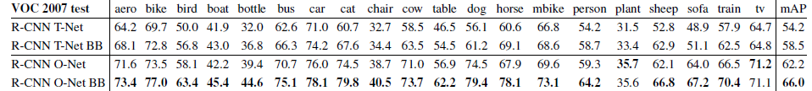
03
3. Visualization, ablation, and modes of error
3.3. Network architectures
We have found that the choice of architecture has a large effect on R-CNN detection performance.
The first two rows are results from Table 2 using Krizhevsky et al.’s architecture (T-Net). Rows three and four use the recently proposed 16-layer architecture from Simonyan and Zisserman (O-Net)
13 layers of 3 * 3 convolution kernels
homogeneous
structure
five max pooling layers interspersed
topped with three fully-connected layers.
Notes:
根据我们的观察，架构的选择在很大程度上影响着R-CNN的表现

Slide 28
03
3. Visualization, ablation, and modes of error
3.3. Network architectures
We have found that the choice of architecture has a large effect on R-CNN detection performance.
The first two rows are results from Table 2 using Krizhevsky et al.’s architecture (T-Net). Rows three and four use the recently proposed 16-layer architecture from Simonyan and Zisserman (O-Net)
13 layers of 3 * 3 convolution kernels
The results in Table 3 show that RCNN with O-Net substantially outperforms R-CNN with T-Net, increasing mAP from 58.5% to 66.0%. However there is a considerable drawback in terms of compute time, with the forward pass of O-Net taking roughly 7 times longer
than T-Net.
homogeneous
structure
five max pooling layers interspersed
topped with three fully-connected layers.
Notes:
根据我们的观察，架构的选择在很大程度上影响着R-CNN的表现
T-CNN和R-CNN增长了准确率，但是拥有计算时间上的缺点，O-Net的计算时间是T-Net的7倍

Slide 29
03
3. Visualization, ablation, and modes of error
3.4. Detection error analysis
We applied the excellent detection analysis tool from Hoiem et al. in order to reveal our method’s error
modes, understand how fine-tuning changes them, and to see how our error types compare with DPM.
A full summary of the analysis tool is beyond the scope of this paper and we encourage readers to consult to understand some finer details (such as “normalized AP”).
3.5. Bounding-box regression
Based on the error analysis, we implemented a simple method to reduce localization errors
Inspired by the bounding-box regression employed in DPM, we train a linear regression model to predict a new detection window given the pool5 features for a selective search region proposal.
Notes:
由于在DPM中得到的灵感，我们训练了一个线性回归模型来预测一个新的检测窗，来进行建议域的选择

Slide 30
4. The ILSVRC2013 detection dataset4.
The ILSVRC2013 detection dataset
04

Slide 31
04
4. The ILSVRC2013 detection dataset
4.1. Dataset overview
train (395,918)
detection dataset
val (20,121)
test (40,152)
These images are scene-like and similar in complexity (number of objects, amount of clutter, pose variability, etc.) to PASCAL VOC images
The val and test splits are exhaustively annotated, meaning that in each image all instances
from all 200 classes are labeled with bounding boxes.
The train set, in contrast, is drawn from the ILSVRC2013 classification image distribution.
Notes:
我们的数据集中的图片场景相似，且复杂度相似（对象的数量，混乱程度，pose的变化性）
验证集和测试集分别非予以标记，即每个图片都被边界盒所标记
而训练集，相反的，是从ILSVRC2013中提取的图像分类

Slide 32
04
4. The ILSVRC2013 detection dataset
4.1. Dataset overview
The nature of these splits presents a number of choices for training R-CNN. The train images cannot be used for hard negative mining, because annotations are not exhaustive.
we have not thoroughly evaluated a large number of choices, we present what seemed like the most
obvious path based on previous experience.
Our general strategy is to rely heavily on the val set and use some of the train images as an auxiliary source of positive examples. To use val for both training and validation, we split it into roughly equally sized “val1” and “val2” sets.
The particular split used here has a maximum relative imbalance of about 11% and a median relative imbalance of 4%.
Notes:
我们把训练集和验证集粗糙地分为val1和val2
这样的特殊区分方法，最大相对失衡是11%，而中值相对失衡是4%

Slide 33
04
4. The ILSVRC2013 detection dataset
4.2. Region proposals
Selective search was run in “fast mode” on each image in val1, val2, and test (but not on images in train).
One minor modification was required to deal with the fact that selective search is not scale
invariant and so the number of regions produced depends on the image resolution.
On val, selective search resulted in an average of 2403 region proposals per image with a 91.6%
recall of all ground-truth bounding boxes (at 0.5 IoU threshold).
This recall is notably lower than in PASCAL, where it is approximately 98%, indicating significant room for improvement in the region proposal stage.

Slide 34
04
4. The ILSVRC2013 detection dataset
4.3. Training data
For training data, we formed a set of images and boxes that includes all selective search and ground-truth boxes from val1 together with up to N ground-truth boxes per class from train (if a class has fewer than N ground-truth boxes in train, then we take all of them). We’ll call this dataset of images and boxes val1+trainN.
CNN fine-tuning,
Training data is required
for three procedures in R-CNN
detector SVM training
bounding-box regressor training
For SVM training, all ground-truth boxes from val1+train were used as positive examples for their respective classes. Hard negative mining was performed on a randomly selected subset of 5000 images from val1.
Notes:
对于训练数据来说，我们编排一个图像和方盒的集合，这里边包含选择搜索和实物盒。

Slide 35
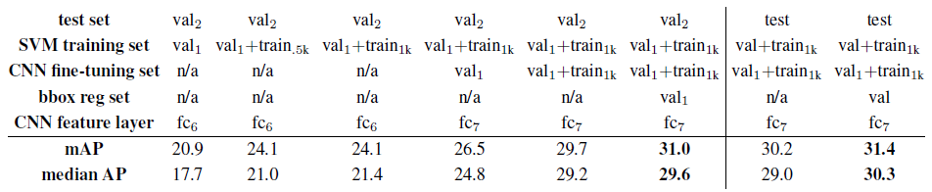
04
4. The ILSVRC2013 detection dataset
4.4. Validation and evaluation
Before submitting results to the evaluation server, we validated data usage choices and the effect of fine-tuning and bounding-box regression on the val2 set using the training data described above
All system hyper-parameters (e.g., SVM C hyper-parameters, padding used in region warping,
NMS thresholds, bounding-box regression hyper-parameters) were fixed at the same values used for PASCAL.
We used the CNN that was fine-tuned on val1+train1k to avoid re-running fine-tuning and feature
computation.
4.5. Ablation study
Notes:
在我们提交我们的实验结果之前，我们对数据，微调的有效率，边界盒的回归在val2上进行了验证。
所有的假想参数被调整为相同的值用于pascal

Slide 36
04
4. The ILSVRC2013 detection dataset
4.6. Relationship to OverFeat
There is an interesting relationship between R-CNN and OverFeat: OverFeat can be seen (roughly) as a special case of R-CNN
If one were to replace selective search region proposals with a multi-scale pyramid of regular square regions and change the per-class bounding-box regressors to a single bounding-box regressor, then the systems would be very similar (modulo some potentially significant differences in how they are trained: CNN detection fine-tuning, using SVMs, etc.).
It is worth noting that OverFeat has a significant speed advantage over R-CNN: it is about 9x faster, based on a figure of 2 seconds per image.
This speed comes from the fact that OverFeat’s sliding windows (i.e., region proposals) are not warped at the image level and therefore computation can be easily shared between overlapping windows
Notes:
R-CNN与Overfeat的关系：OverFeat可以看做R-CNN的一种特殊情况。
如果以多常规正方形的多尺度椎体来代替选择搜索的建议域，并且将每个类的边界盒回归改为单边界盒回归，则这样的体系会非常简单
OverFeat的速度是R-CNN的九倍，但意义并不大，这样的速度是基于这样的现实：OverFeat的滑动窗口（region proposal）并没有弯曲图像的层级，因此计算量可以在重叠的窗口之间进行共享

Slide 37
05
Semantic segmentation

Slide 38
05
5. Semantic segmentation
Region classification is a standard technique for semantic segmentation, allowing us to easily apply R-CNN to the PASCAL VOC segmentation challenge
To facilitate a direct comparison with the current leading semantic segmentation system (called O2P for “second-order pooling”) , we work within their open source framework
Uses CPMC to generate 150 region proposals per image
O2P
predicts the quality of each region
for each class, using support vector regression (SVR).
The high performance of their approach is due to the quality of the CPMC regions and the powerful second-order pooling of multiple feature types (enriched variants of SIFT and LBP).
Notes:
域分类是一种语义分段的标准法，他使我们较为简单地对Pascal voc应用CNN
我们使用一种开源框架用来与目前较为领先的一种语义分段系统（名为O2P）进行比较
O2P的特点有，使用CPMC来对每幅图像产生150建议域，并且预测每个建议域的质量，每个类中，使用SVR

Slide 39
05
5. Semantic segmentation
5.1CNN features for segmentation
However, these features ignore the non-rectangular shape of the region.
Two regions might have very similar bounding boxes while having very little overlap.
The first strategy (full) ignores the region’s shape and
computes CNN features directly on the warped
window, exactly as we did for detection
We evaluate three strategies for computing features on CPMC regions
Therefore, the second strategy (fg) computes CNN features only on a region’s foreground mask. We replace the background with the mean input so that background regions are zero after mean subtraction.
The third strategy (full+fg) simply concatenates
the full and fg features; our experiments validate their complementarity.
Notes:
三种在CPMC域上计算特征的方法：
1.忽略域的形状，并且在窗口直接计算CNN特征，但是这种策略下，非矩形的域往往会被忽略，在重合较少的时候，两个域往往会拥有非常相近的边界盒。
2.所以第二种策略则是仅在域的前景模板层计算CNN特征。我们使用均值输入代替背景，因此背景域在去均值后变为零
3.第三种侧策略：将full与fg结合

Slide 40
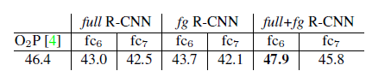
05
5. Semantic segmentation
5.2 Results on VOC 2011
Within each feature computation strategy, layer fc6 always outperforms fc7 and the following discussion refers to the fc6 features.
Segmentation mean accuracy (%) on VOC 2011 validation. Column 1 presents O2P; 2-7 use our CNN pre-trained on ILSVRC 2012.
Our method achieves the highest segmentation accuracy for 11 out of 21 categories, and the highest overall segmentation accuracy of 47.9%, averaged across categories (but likely ties with the O2P result under any reasonable margin of error). Still better performance could likely be achieved by fine-tuning.
Notes:
我们的实验结果与两种baseline（R&P，O2P）比较

Slide 41
06
Conclusion

Slide 42
06
6. Conclusion
In recent years, object detection performance had stagnated. The best performing systems were complex ensembles combining multiple low-level image features with high-level context from object detectors and scene classifiers.
This paper presents a simple and scalable object detection algorithm that gives a 30% relative improvement
over the best previous results on PASCAL VOC 2012.
The first is to apply high-capacity convolutional neural networks
to bottom-up region proposals in order to localize and segment objects.
We achieved this
performance through
two insights
The second is a paradigm for training large CNNs when labeled training data is scarce. We show that it is highly effective to pre-train the network— with supervision—for a auxiliary task with abundant data (image classification) and then to fine-tune the network for the target task where data is scarce (detection）
We conclude by noting that it is significant that we achieved these results by using a combination of classical tools from computer vision and deep learning (bottom up region proposals and convolutional neural networks).
Notes:
近些年来，对象检测的表现趋于停滞，之前最为先进的方法，其复杂度较高，并且将多重的低级图像特征和高级文本内容所结合。
这篇文章提出了一种简单可测量的对象检测算法，该算法在Pascal VOC2012上比之前业内最好的结果高出30%
我们的成果主要体现在以下两个方面：
1.为了局部化分段对象，我们应用了高容量的卷积神经网络，来自底向上获取建议域
2.当训练数据较少时，我们训练大型的CNN；当数据较大时，我们使用效率较高的预训练网络作为辅助任务

